Slide 1

Little’s Law
Presented by:
Elizer Ponio Jr.
Department of Computer Science
College of Computing and Information Technologies

Slide 2
Queueing system
A queueing system can be described as the flow of items through a queue.

Slide 3
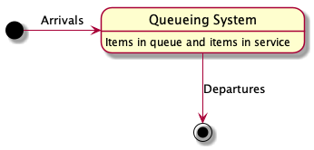
Queueing system
In a queueing system,
1. Items arrive at some rate to the system and join one or more queues inside the system.
2. Items receive some kind of service.
3.and when the work is done, they depart the system.

Slide 4
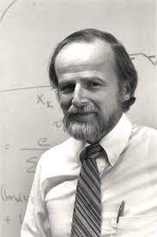
Introducing Little’s Law
Little’s Law is a simple model of queueing systems.
Introduced by MIT John Little in 1954.
Has been used in a variety of applications such as project management, software architecture and software development.

Slide 5
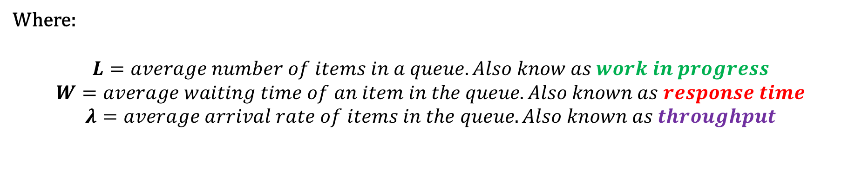
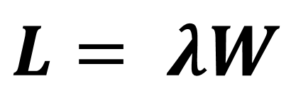
Introducing Little’s Law
$$L= λW$$
Where:
$$L=average number of items in a queue. Also know as work in progress$$
$$W=average waiting time of an item in the queue. Also known as response time$$
$$λ=average arrival rate of items in the queue. Also known as throughput$$

Slide 6
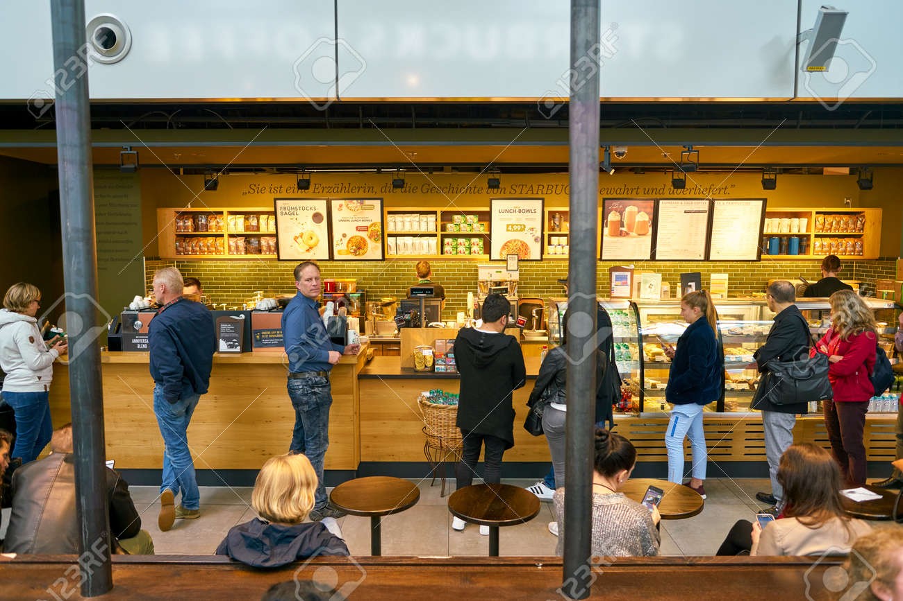
Little’s Law Example
Imagine you have a starbucks coffee shop with 10 customers arriving at every minute.
It takes them about 30 seconds to find the drink they want, after that they pay and leave.
It means that your coffee shop will have 5 customers at any given time.

Slide 7
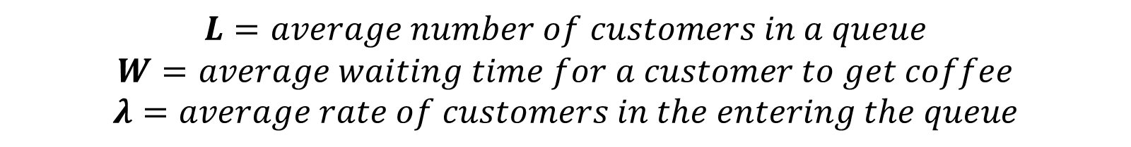
Little’s Law Example
$$L=average number of customers in a queue$$
$$W=average waiting time for a customer to get coffee$$
$$λ=average rate of customers in the entering the queue$$

Slide 8
Little’s Law Example
Imagine you have a starbucks coffee shop with 10 customers arriving at every minute.
It takes them about 30 seconds to find the drink they want, after that they pay and leave.
It means that your coffee shop will have 5 customers at any given time.
$$L= λW=10 ∗0.5=5 customers$$

Slide 9
Little’s Law Example
But what if 10 customers is not the number of customers that would meet your business needs?
What if you launched a marketing campaign and managed to increase the number of customers arriving from 10 to 20 customers every minute?
$$L= λW=20 ∗0.5=10 customers$$

Slide 10
Little’s Law Example
Great! You managed to increase the number of customers in your shop who want to make a purchase.
But your cashier can’t seem to keep up with the increase. This is where you may need to consider either hiring more staff or increasing your prices to suit demand.
But, hiring another seller also means that now you’ll have to pay two salaries, which is another factor to consider if you are looking to increase your revenue.

Slide 11
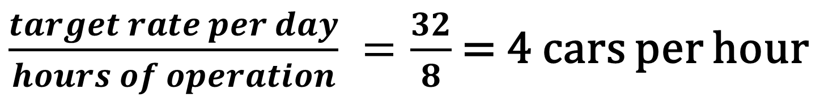
Little’s Law Example
Imagine you work in a car factory and your boss wants to produce 32 cars per day and the factory operates 8 hours a day.
Question: How many cars does the factory need to produce every hour?
Answer: 4 cars per hour
$\frac{target rate per day}{hours of operation} =\frac{32}{8}$ = 4 cars per hour

Slide 12

Little’s Law Example
Imagine you work in a car factory and your boss wants to produce 32 cars per day and the factory operates 8 hours a day.
Question: If 4 cars can be produced every hour. What is the total amount of time it takes to produce 1 car ?
Answer: 1 car is produced every 15 minutes
$\frac{minutes}{cars produced per hour} =\frac{60}{4}$ = 15 minutes

Slide 13
Little’s Law Example
Imagine you work in a car factory and your boss wants to produce 32 cars per day and the factory operates 8 hours a day.
Question: If the throughput is 2 hours and the response time is 4 cars per hour, what is the average number of cars in the production line?
Answer: 8 cars
$$L= λW=2∗4=8 cars$$

Slide 14
Little’s Law Example
Imagine you work in a car factory and your boss wants to produce 32 cars per day and the factory operates 8 hours a day.
Question: If we reduce the throughput from 2 hours to 1.5 hours and the response time is 4 cars per hour, what is the average number of cars in the production line?
Answer: 8 cars
$$L= λW=1.5∗4=6 cars$$

